Slide 1


GREEN ENERGY MARKET INTELLIGENCE DASHBOARD
FROM NATURE, FOR THE FUTURE
BY SHREYA MISHRA
01

Slide 2
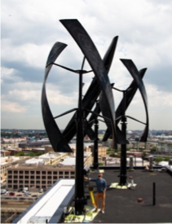
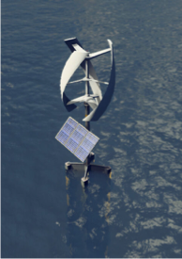
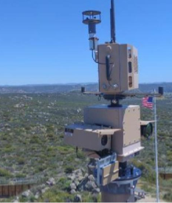

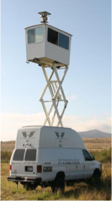
PRODUCTS
DualForce
Wind and Solar Hybrid Turbine
•Dual Charging System
•Smart Energy Management
•Modular Design
AeroSpin
Advanced Wind Turbine
•Enhanced Durability
Bird-Safe Technology, Noise reduction technology
GuardianWind
Military-Grade Turbine with Ammunition
•Non-lethal ammunition capabilities
•Remote Operation
•Energy Self-Sufficiency
SecureSpin
Security-Enhanced Turbine
•Surveillance Integration
•Data Encryption
WeatherWise
Integrated Weather Station Turbine
•Comprehensive Weather Sensing
•Real-time data analysis

Slide 3




CREATIVES
C1: Mixed Reality Experience: " Renewable Defender”
C2: Global Challenge: "Eco-Hackathon"
C3: Strategic Partnership and Collaboration with Organizations
C4: Sponsoring Events and Engaging in Digital Content

Slide 4
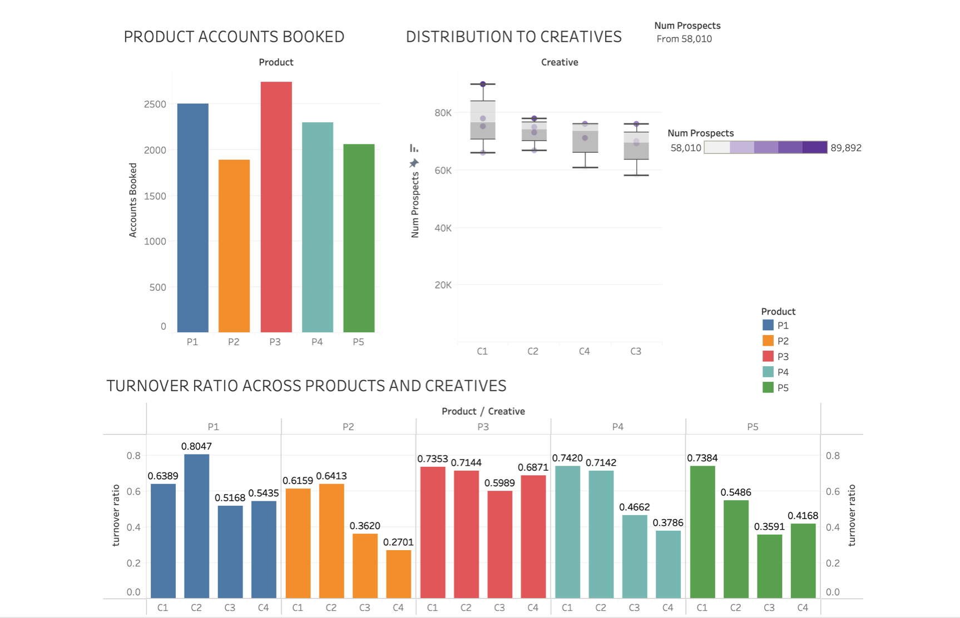

Slide 5
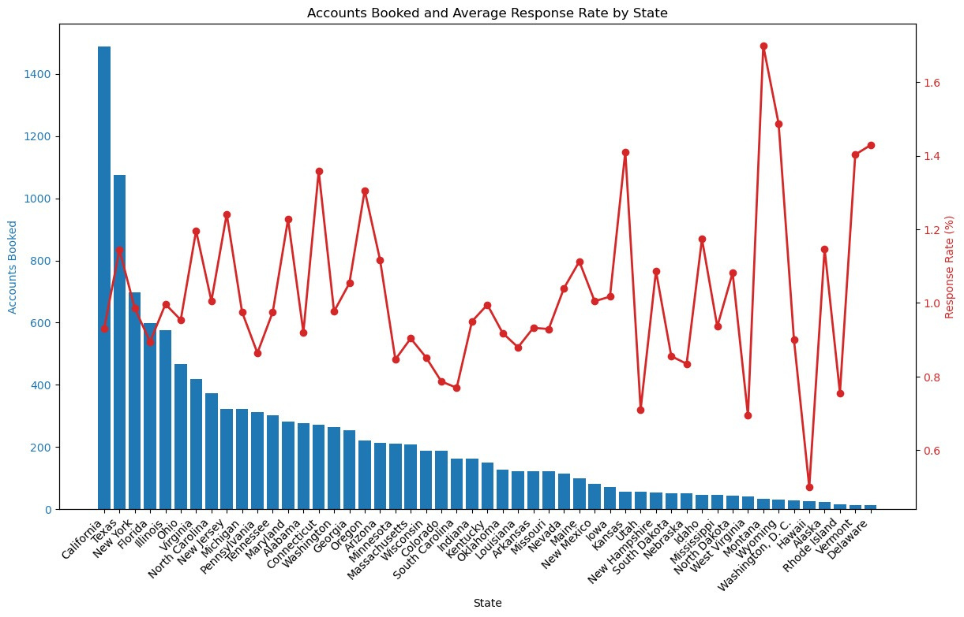

Slide 6
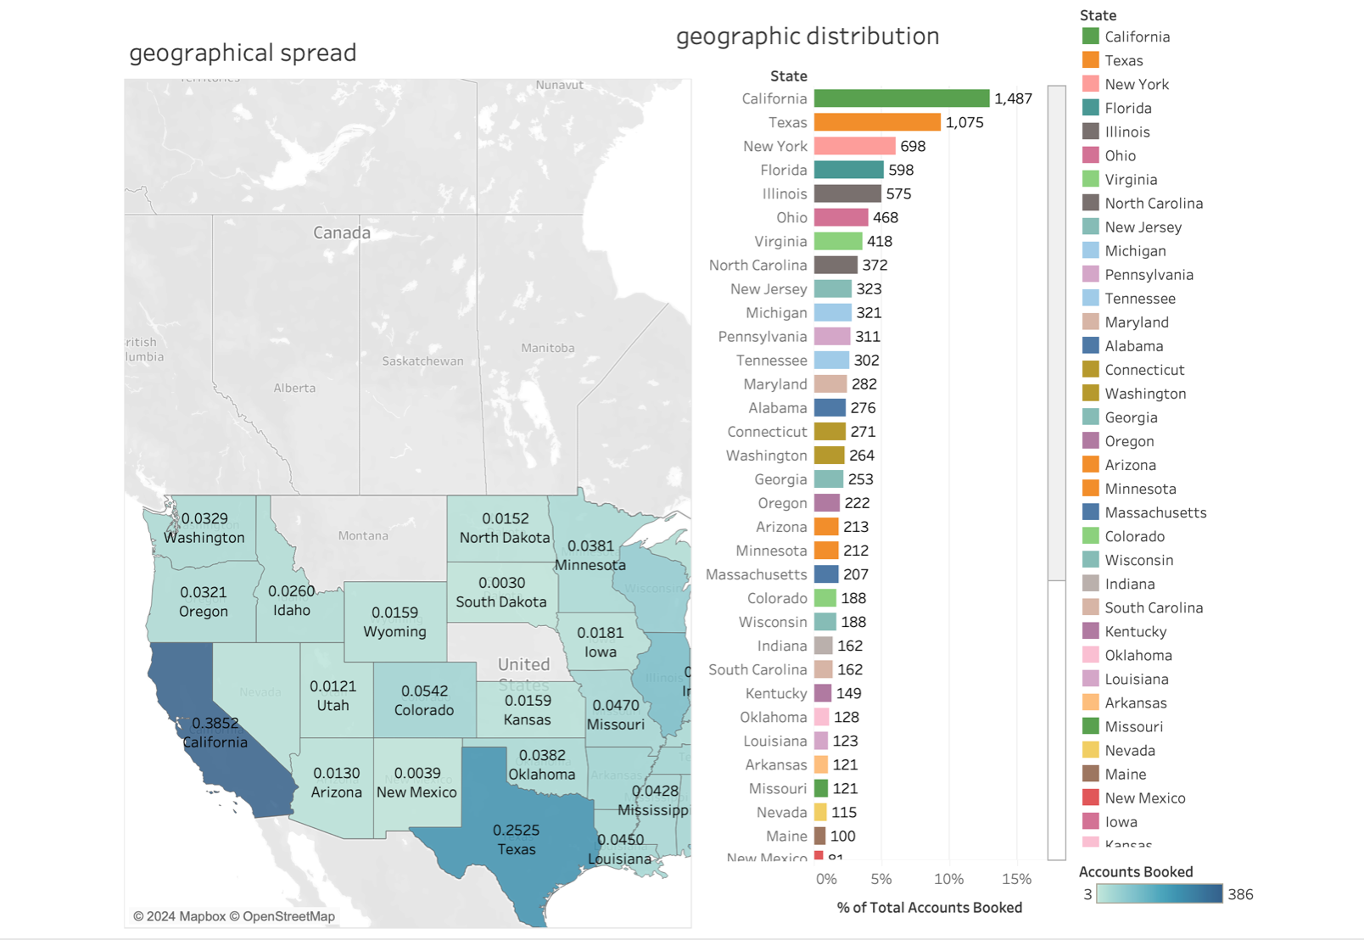

Slide 7
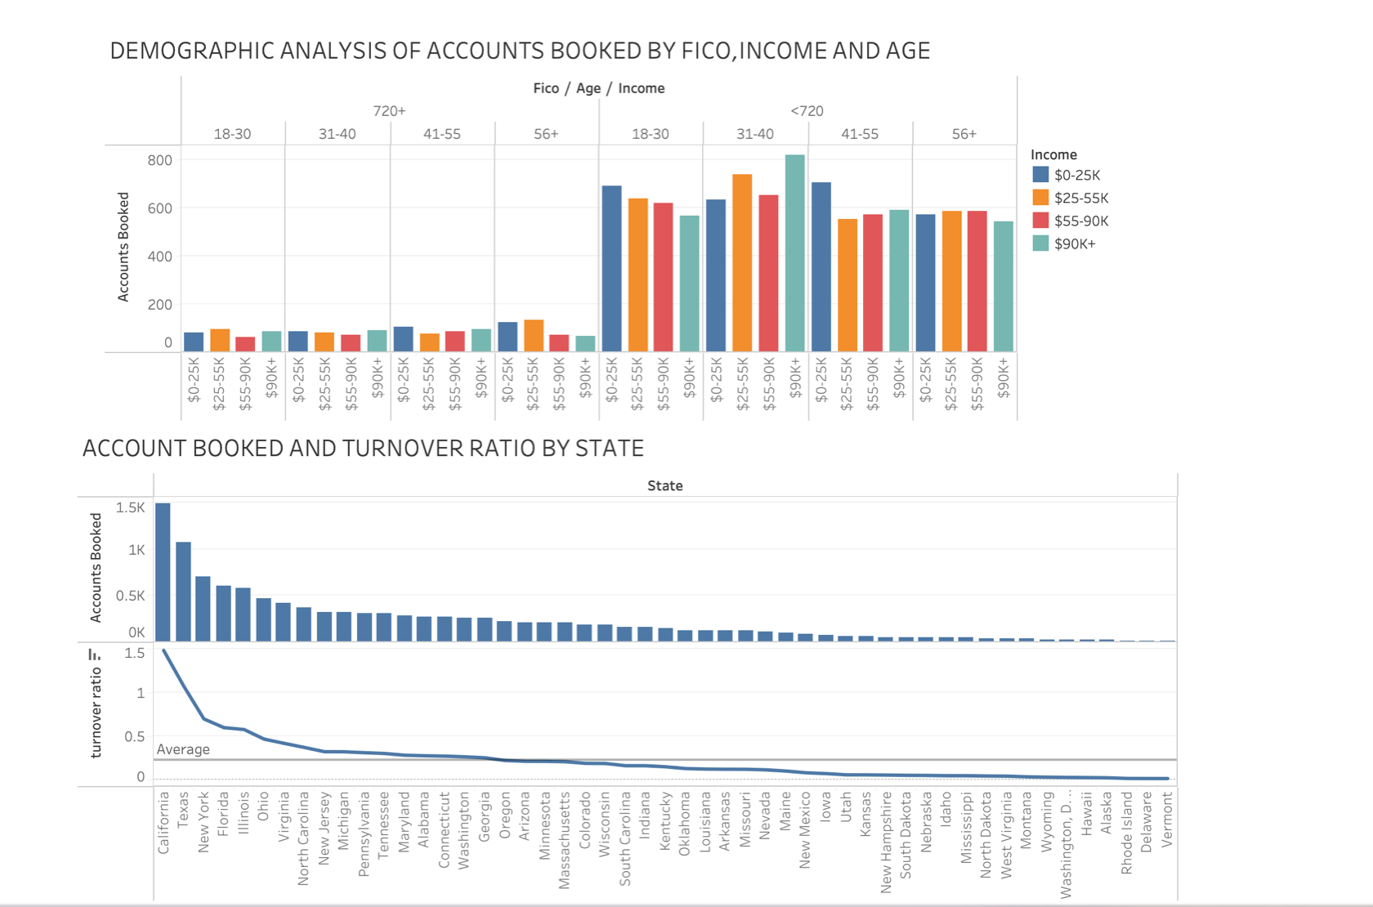

Slide 8
SUMMARY OF ANALYSIS
Product Accounts Booked:
Product P5 shows the highest number of accounts booked, followed by P4 and P3. Products P1 and P2 have lower bookings.
Distribution to Creatives:
Creatives C3 and C4 are utilized less in terms of the number of prospects, despite the high total number of prospects available (over 58,000).
Turnover Ratio:
High turnover ratios indicate better retention or repeat business. Product P5 paired with C4 shows a high turnover ratio, while P2 paired with C1 has the lowest, indicating potential issues in product-market fit or creative execution.
Geographic Distribution:
California, Texas, and New York show high accounts booked, suggesting a stronger market presence or acceptance. Other states show a lower engagement that could be explored further.
08

Slide 9
RECOMMENDATIONS
Optimize Creative Allocation:
Action: Better Creatives, especially for Products P1 and P2 viz. DualForce and AeroSpin
Reasoning: Creative C1 is over-utilized across all products despite lower turnover ratios (e.g., P2 and C1 at 0.3620). Creatives C3 and C4 show potential under-utilization but maintain a moderate performance metric that could be capitalized upon to boost P1 and P2 performance.
Product Positioning and Targeting:
Action: Increase marketing and promotional activities for P1 and P2 in states with low engagement but high overall accounts booked like Illinois and Florida.
Reasoning: Despite lower overall bookings for P1 and P2, focusing marketing efforts in high-volume states could increase market share. The demographic analysis suggests that different states may respond differently to marketing strategies or product offerings.
Tailored Marketing Campaigns:
Action: Campaigns for P4 (SecureSpin) and P5 (WeatherWise) leveraging their existing strong performance to boost turnover rates in underperforming regions - make use of testimonials and public forums.
Reasoning: P4 and P5 show strong booking numbers but varied performance across states and creatives. Use high-performing combinations (like P5 with C4 (Sponsoring events and content)) be adapted to similar markets with less penetration.
08

Slide 10
THANK YOU

